Slide 1

Weee! Are the Champion
Team 2: Sarah Chen; Gemma Liang; Lillian Xie;
Haoxiong Qin; Pariya Pusayapaibul; Rajshree Bagadia

Slide 2
Agenda
Company Overview
SWOT Analysis
Target Audience & Customer Journey
Industry Highlights
Competitor Analysis
Current CRM Strategy & Vendor Analysis
Other CRM Vendor Analysis
New CRM strategy recommendations
Current CLV vs Future CLV

Slide 3
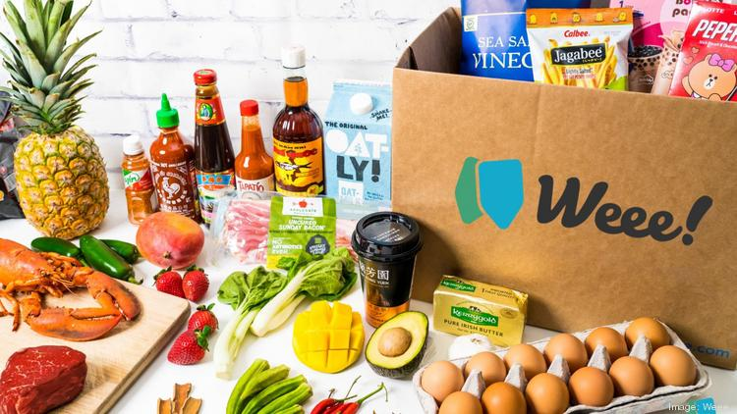
Company Overview
Offering: Weee! is the largest online grocery store, which specializes in Asian and Hispanic food in North America.
Position: Enable affordable access to groceries and to deliver hard-to-find goods directly to customers.
To-be position: Become one stop service for food supply by expanding service areas and ecosystem.

Slide 4
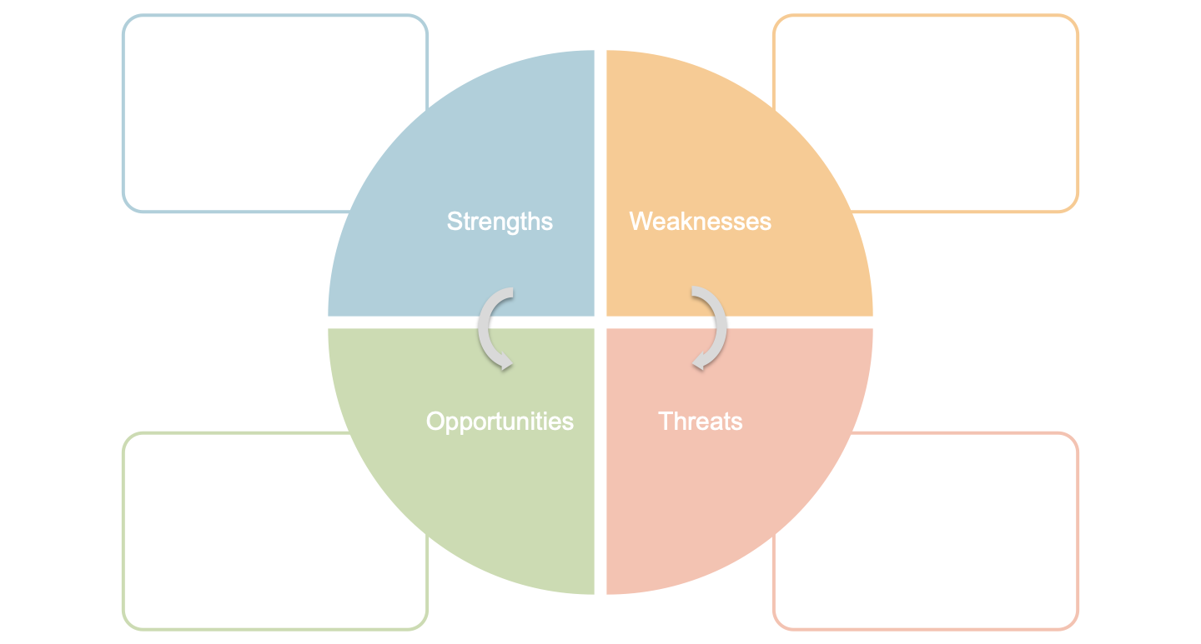
SWOT Analysis
Largest platform
Provide wide range of products
Largest number of followers
Low retention rate
High acquisition rate
Negative feedback for food quality
Increase retention rate
Gain more market share
Use WOM effect
Private label snacks/food
Intense competition
Business model easy to copy

Slide 5
Target Audience
Asian
The minority population in the US is 90 million (30% of the total population)
Maintain an annual growth of 3-5% in the future
The minority grocery e-commerce market is an incremental market
These users' annual food consumption in the US will reach $470 billion in 2023
Chinese, Japanese, Korean
Hispanic
Mexican, Cuban
International Students
Stay in the US for 1-5 years
Different in CLV calculation

Slide 6
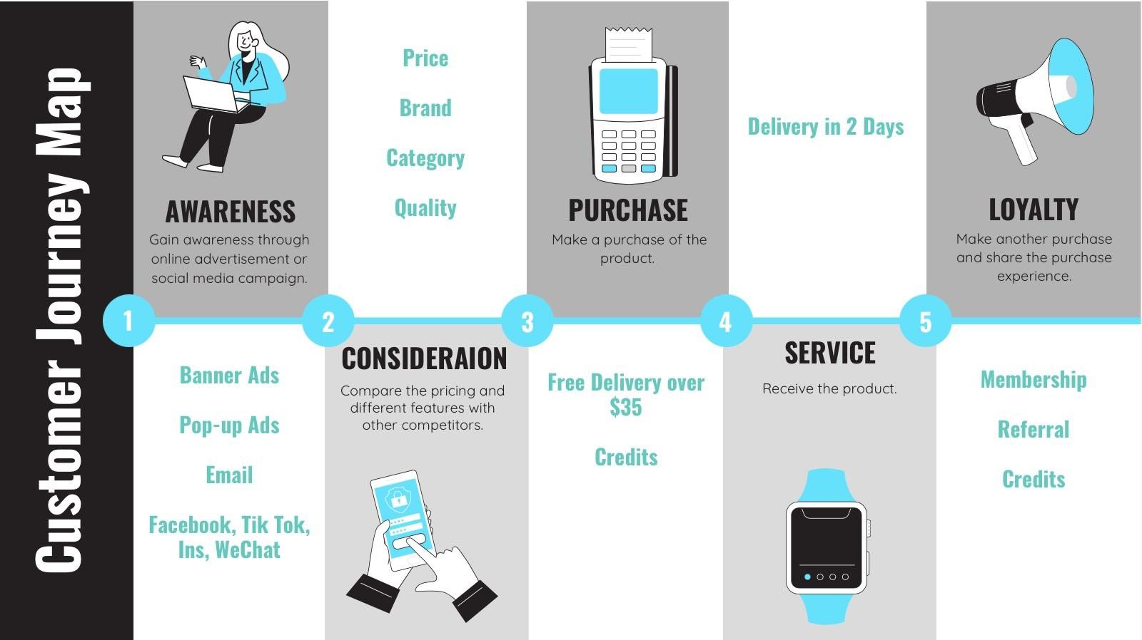
Customer Journey

Slide 7






Digital Ecosystem
To-be:
Consistent brand style
Avoid Vendor Lock-in
Have 100% control
Integrate ad & data analytics
Ads/Media
Logistics
Subsidiary-
Food Delivery
Own Driver
Management System
Global Network of Demand, Inventory, Labor & Distributions
Data Analytics
Supply Chain
Dashboard
Own Business Dashboard Platform

Slide 8
Marketing Channels
Paid Media
SEO
Blog
Social Media Ads
Paid content promotion
Earned Media
Mentions
Shares
Reposts
Reviews
Owned Media
APP
Website
Social Media Channel:
Facebook; Instagram; Wechat; LinkedIn; YouTube; Twitter

Slide 9
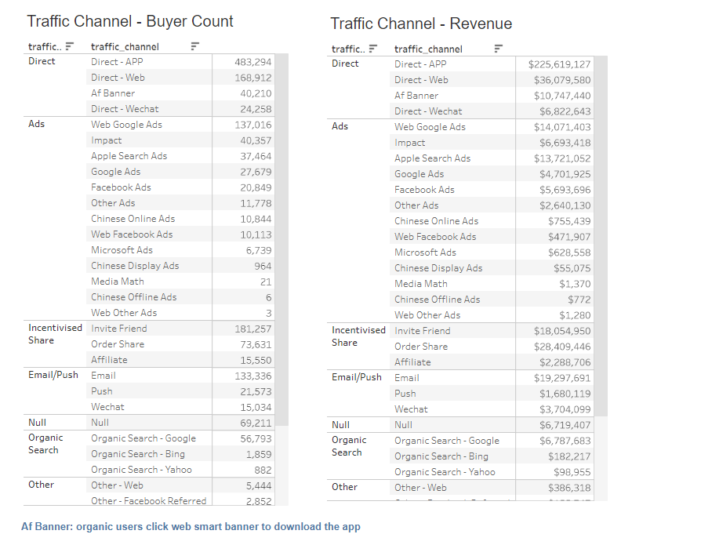
Future Channels to focus on:
Direct from APP
Incentivised Share
Email/Wechat

Slide 10
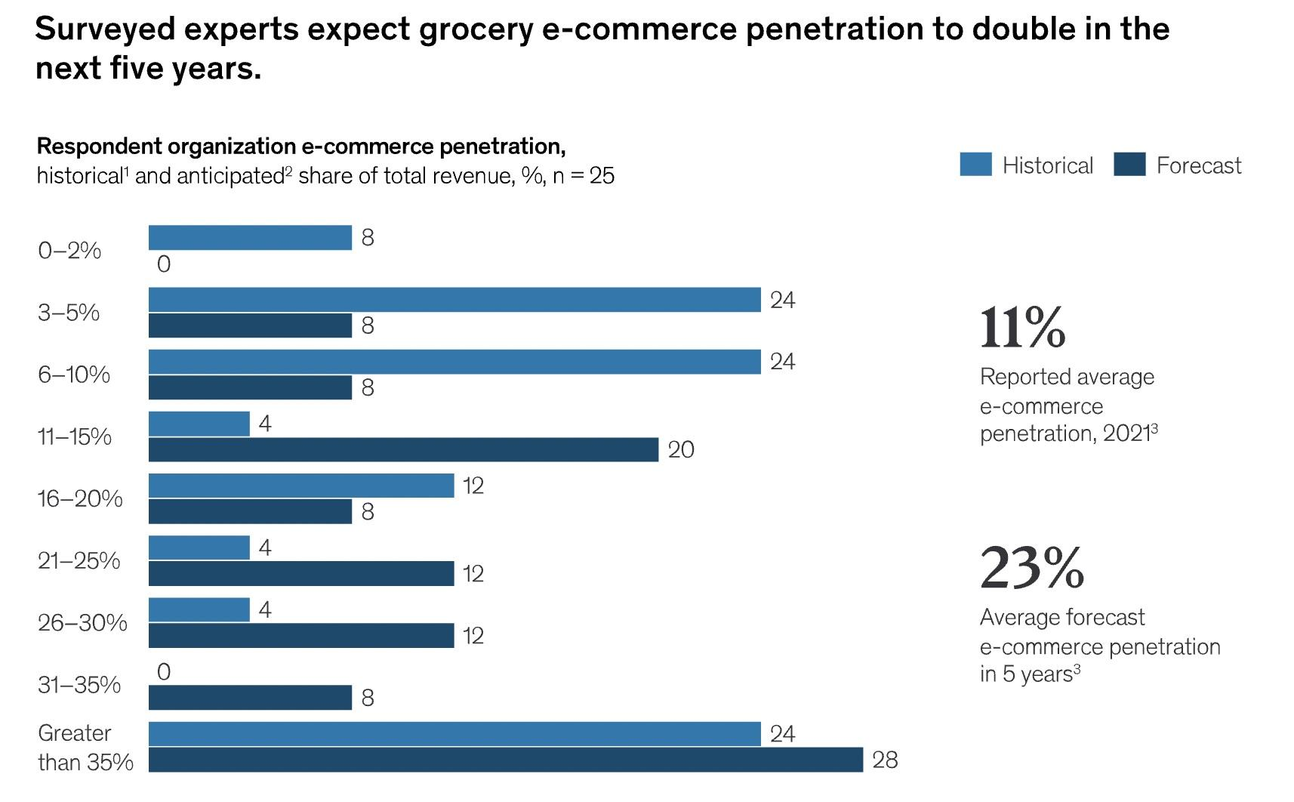

Industry Highlights
Notes:
The industry is now on the edge of the next transformation in e-commerce: grocery executives expect e-commerce penetration to more than double for their own organizations in the next three to five years, to an average of 23 percent (Exhibit 1).

Slide 11
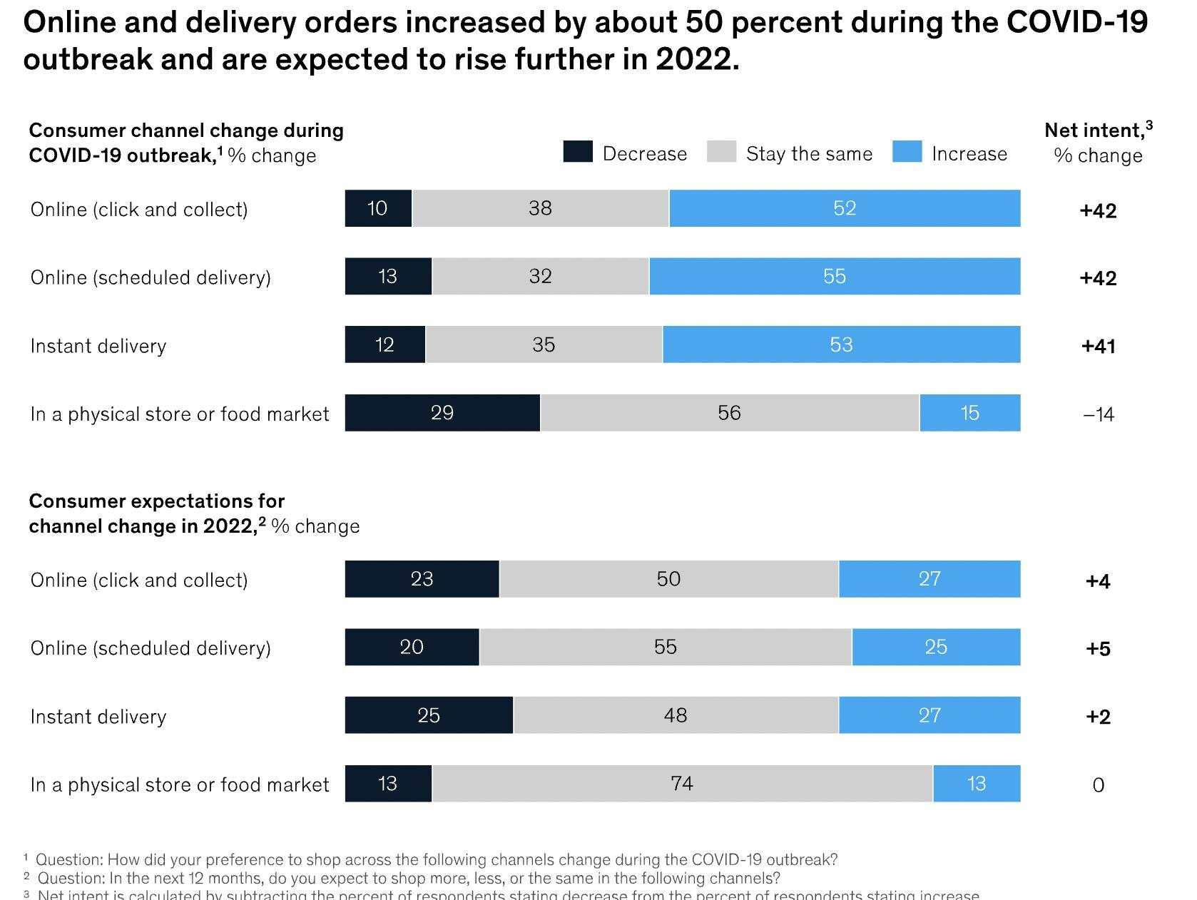

Slide 12
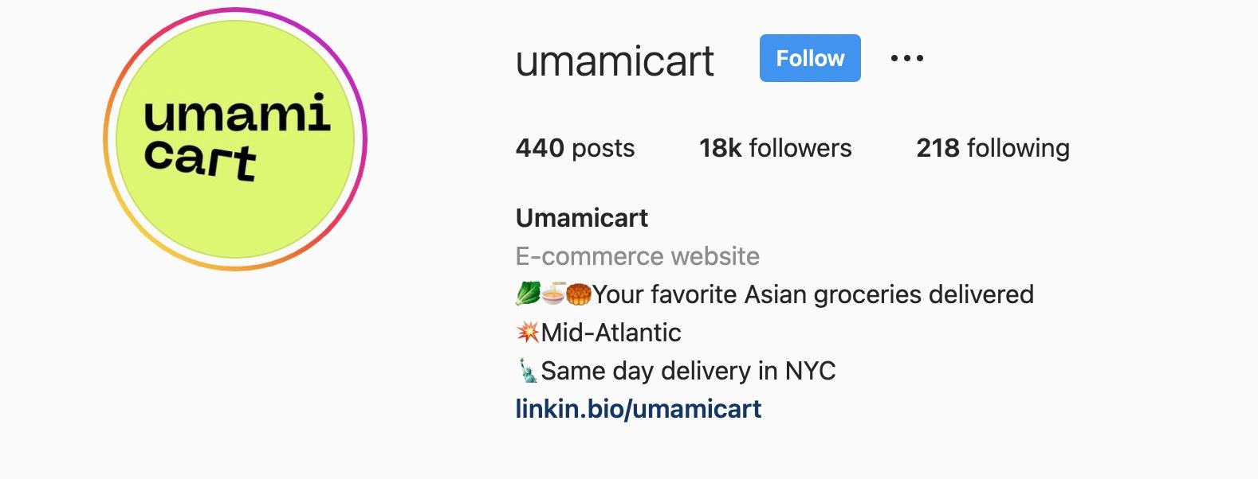
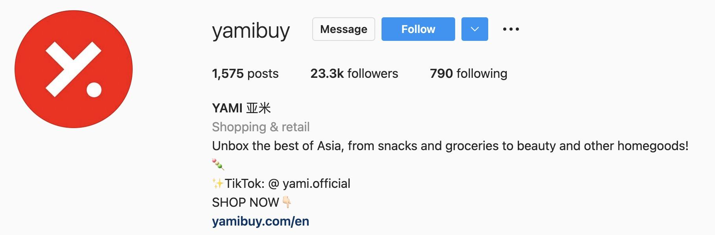
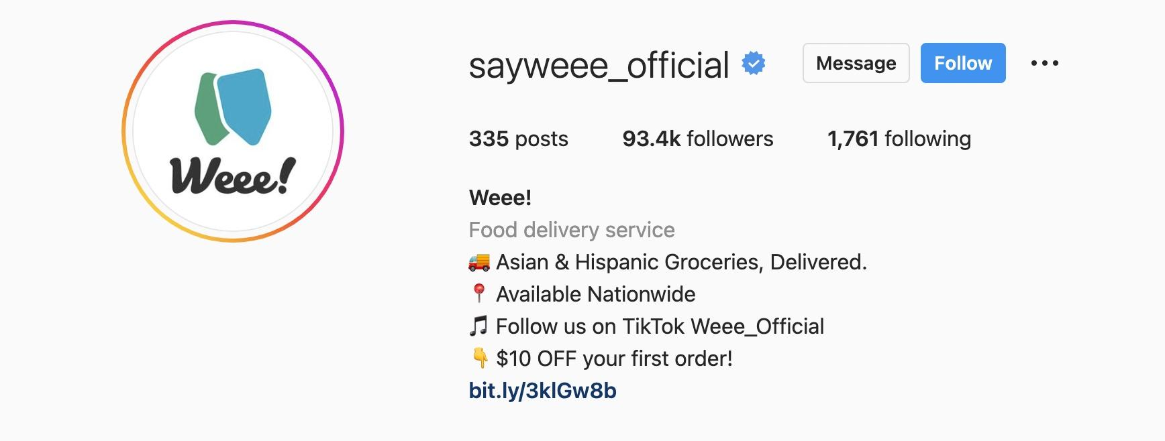
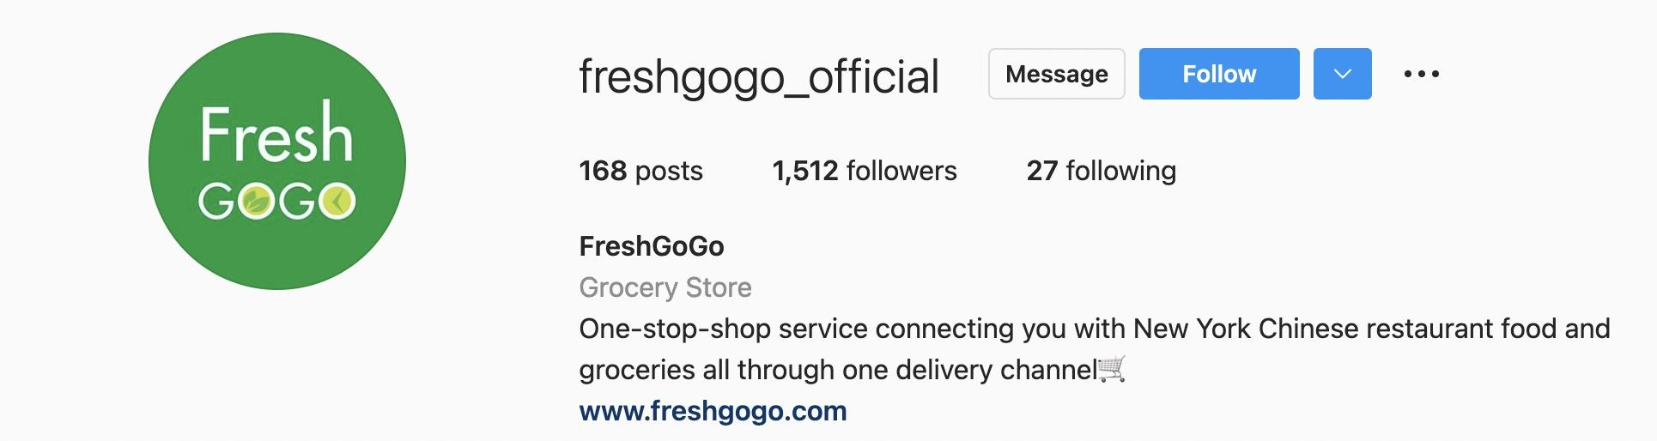
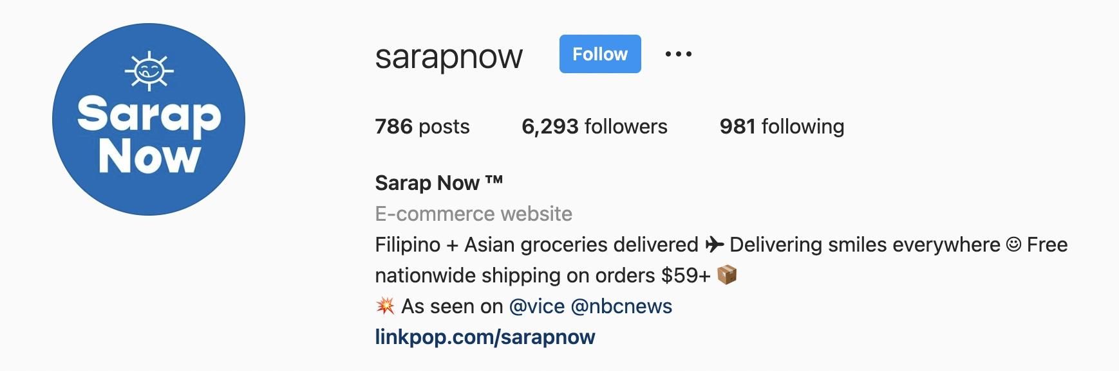
Direct Online Competitor

Slide 13




Company
Product Variety | Asian & Hispanic groceries and snacks | Asian groceries | Asia snacks; Beauty products | Chinese Restaurant Food & Asian groceries | Filipino & Asian groceries
Delivery Time | 2-3 days | Same day delivery in NYC | 5-7 days | 2-3 days | 2-4 business days
Minimum order for free delivery | $35 | $49 | $49 | No free delivery | $59
Membership | $10.99 for 1 month or $99.99 for 1 year |  |  | $9.99 for 4 weeks or $99.99 for 52 weeks

Slide 14
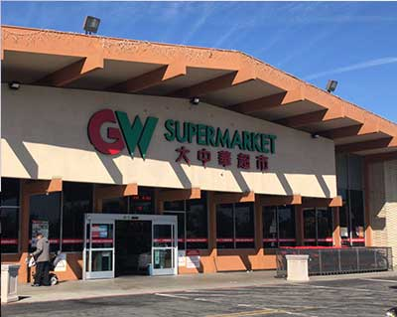

Offline Competitor
Great Wall Supermarket
H Mart

Slide 15
Positioning Map
High Product Variety
Less Delivery Time

Slide 16
Current CRM Strategy Evaluation
Customer Management
Strategic customer management principles
In-depth knowledge of potential customers of all ethnicities in the US
Treat customers as asset when growing
Integrate CRM strategy to brand identity and company culture
Part 1
Organizational Process Integration & Alignment
Business is at core of everything; CRM is organized in order-centric rather than customer-centric
Lack a comprehensive & cohesive solution to implement the principles into business conducts

Slide 17
Current CRM Strategy Evaluation
CRM Strategy Implementation
Acquisition: too dependent on coupons; need to find other methods to acquire more users of other ethnicities
Retention: continuous large marketing expenditure on promotional notifications, weekly discounts, social media advertisement, etc.
Reactivation: customers feel indifferent about small discounts, costly and inefficient
Part 2
Data Capture & Technology Integration & Alignment
Well-established company-owned Dashboard that can capture, store, and analyze customer information daily
Have to switch to other platforms like Tableau & Kibana for complex analysis

Slide 18
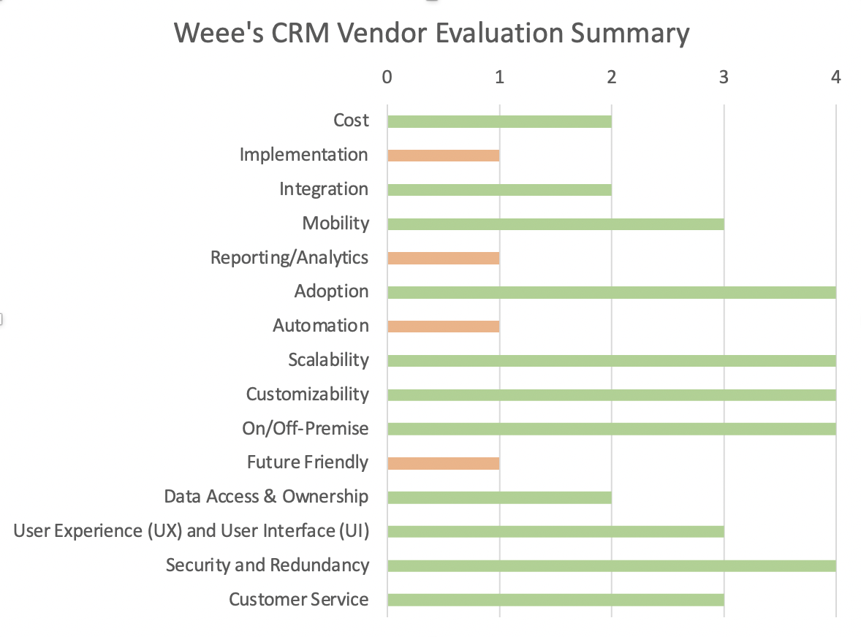
Current CRM Vendor Evaluation
Evaluation
Poor implementation of CRM strategy through the existing vendor
Rely on outside platforms to conduct complex analysis and process large data; oversimple reporting
Lots of repetitive work, require higher automation to improve efficiency
Limited functions & insufficient analysis capability cannot support future growth
Own Business
dashboard:
Weee! Dashboard
Data Analysis Tools:
Kibana, Tableau
Notes:
the CRM system is embedded in the dashboard of Weee. it helps employees to keep track of daily business flows. However, the system is not capable of managing large data that involves complex analysis, so these are conducted in other platforms: Tableau and Kibana.
Through the our analysis based on the rubrics, weee’s vendor fall short under four metrics showed in orange, which are implementation, reporting/analytics, automation and future-friendly.
Implementation: not be well implemented via the current system, for instance, they cannot single out truly potential users and focus marketing resources on them.
Need to rely on outside sources and platform to process large data and perform complex trend analysis
There are some repetitive work that still require human effort like classification of the charts. Also, system is not integrative and require timely switching, so its automation process needs improvement.
The vendor’s limited function and simplistic analysis capability have constrained Weee’s future development.

Slide 19
Challenges
Strategy
Vendor
Unsatisfactory acquisition
Attract too many one-time users.
Lack of methods to improve retention rate
Continuously use large discounts to attract repurchase;
Unable to resolve high churn rate of student users.
High expenditure in reactivation stage
Huge marketing cost on advertisement, social media ads, email & push marketing on users as long as expected profits > marketing cost.
Hard to build customer loyalty
Lack brand influence among users
Inconvenience of switching between platforms
Lack an all-round CRM solution.
Out-of-touch with CRM strategic goals
Order-centered rather than user-centered.
Low efficiency
Insufficient automation process keeps pressuring human resources.
Functions cannot meet future needs
No strong technical support, eg. more customized data visualization, big data analysis, AI-based insights, optimization advice.
Notes:
Acqui: money burning in early stages, a lot of users flood in just for the good bargain.
Retention: hands are tied. They lured the customers by a good bargain, their reference point drop, and only a better bargain can make them stay.
Reactivation: Based on tradeoff analysis per user, Weee would spend as many budget they want to reactivate user if this user’s expected profits can make up the marketing cost. Which is not cost- nor time-efficient.
Customer loyalty: weee as a brand lack influence on their consumers, and the consumer loyalty are for the price, the products, not for weee per se.
Nancy mentioned inconvenience of operations cross platforms.
Weee’s CRM system is part of its business operation system, and is built as order-centered. Users data are given not enough wight as it should be, and make the CRM deviate from the strategic goal of recruiting more consumers to closing more deals.
The system is requires automation updates in many business processes;
Lastly, the vendor has too simple functions to support future growth. It demands more intelligent features such as customization, ai-based insights and optimization advice

Slide 20
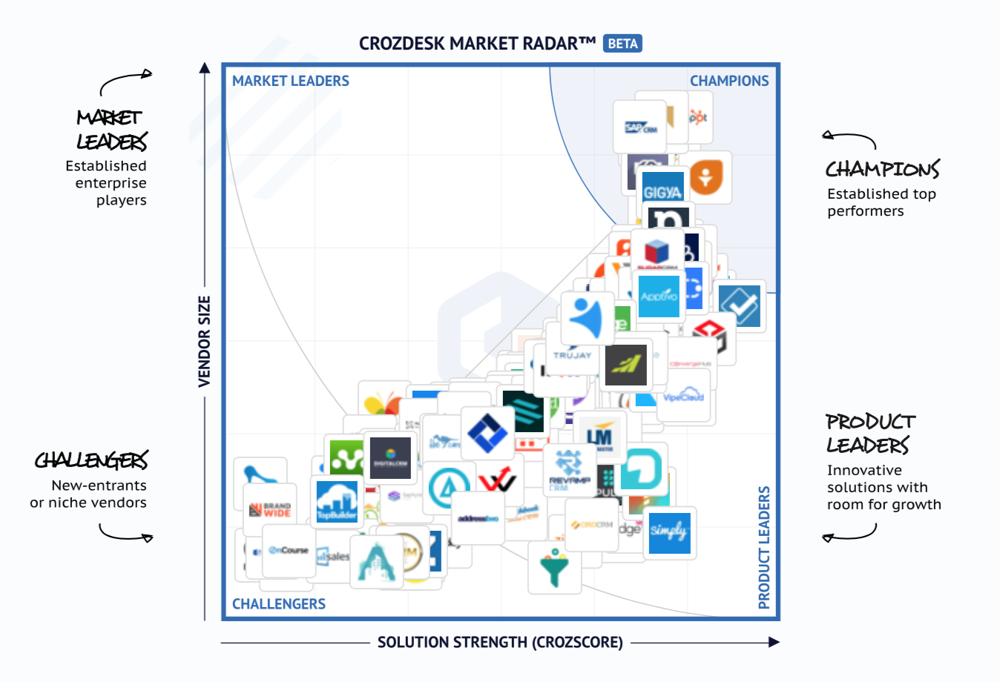
Vendor Analysis
Vender Markets
Retail support system is mature
Service for large e-commerce platform is a rare find
Principles
Based on the problem Weee! has on its current system
Customer-centered integrated system
Selection
We chose 6 out of 20 vendors that we believe might suitable for Weee!

Slide 21
Main Problems
Reporting and Analytics
Automation
Implementation
Future friendly
Notes:
So while doing our vendor analysis, we kept the four main problems that Wee is facing in mind as mentioned earlier by lillian which are
Reporting and Analytics - Not sufficient to fulfill the existing needs of the reporting and analytics of the company as they have to rely on other platform which leads to wasting of employees time.
Automation - Require better automation tools to improve its effeciency
Implementation - Poor implementation of their strategy through current crm system
Future friendly- Due to these issues it is less future friendly for the company to use this platform

Slide 22
Evaluation Weight Model
Coefficient Value
4 Points
3 Points
2 Points
Integration
Reporting/Analytics
Automation
Future Friendly
Implementation
Adoption
Cost
Scalability
Customizability
On/Off Premise
Data Access & Ownership

Slide 23
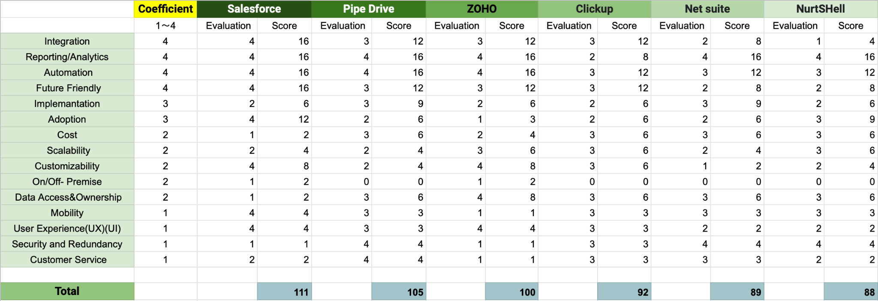
Vendor Comparison Chart
*See more on support document

Slide 24

Plan A : Salesforce
Integration
Reporting/Analysis
Automation
AppExchange;
200+ technology partners
built-in 7 Reports
A/B Testing
AI-powered Personalized Customer Experience
B2B2C Commerce Service
+
Order Management
1% Gross Merchandise Value
$0.5/order
Cost :
≈ $4.37M
* This edition requires an annual contract and a 20,000 order minimum.

Slide 25

Plan B : Pipedrive
Reporting and Analytics
Automation
Can be customized
Custom Fields and reports
Revenue forecasting
Performance
conversion reports
AI sales assistant
Workflow Automation
Smart connect data
Cost
99$ /month & 400+users
Approx = 39600 monthly
=$ 475k
Implementation and Integration
Future Friendly
Swift implementation process
Good interface that allows you to build integration with the application used
Viable in foreseeable future
Robust customer service 24*7
Technical support to premium members
Notes:
Second option that Weee! has if Salesforce is very expensive is to adopt Pipedrive as their CRM platform. Pipedrive is a cheaper platform as compared to Salesforce and would cost around $475K per year.
Pipedrive believe that in sales (and in life) you can't control results, but you can control the actions that drive deals towards completion. This also makes the platform more user centric and not order centric.
So Weee could use Pipedrive as its Reporting and analytics- Can customize based on its needs and it also offers
Automation- The automation tools that pipedrive can provide Weee are AI sales assistant, Workflow automation and smart connect data. With Pipedrive, you can automate just about any step of your sales process. For example, you can trigger personalized email templates that go out whenever you create a deal, or move a deal along a pipeline stage, keeping leads warm while focusing on high-priority tasks. The AI-powered sales mentor further boosts the performance by providing personalized tips and recommending which Pipedrive features and app integrations can do the grunt work for you.
Implementation and Integration
It is easy to use as it made with the focus for busy salespeople and therefore the implementation is fairly a swift process
​​Pipedrive has ready-made integrations with, e.g., Google and Microsoft calendar, email, and contacts. You can also combine your favorite video conferencing software (Google Meet, Microsoft Teams, and Zoom). The Pipedrive marketplace also has more than 275 ready-made integrations. It has Good interface that allow to build integrations with the applications the company use.
Future Friendly - Lastly Pipedrive is viable in foreseeable future as it suffice some of the major problems which We is currently facing
It also provides strong technical support as well as robust customer services 24*7.

Slide 26
Plan C : Changes in existing platform
Advanced Analytics
Advanced analytics and predictive analytics
Integration with other platform
Better data visualization reports
Make changes in the existing platform
Costly but profitable in longer run
Cost might be 3 times more than current cost.
Automation Tools
Better automation tools like :
AI powered and recommendation system
Customer card
Provide complete information of customer which may be demographic, purchase history, preferences
Notes:
-Next thing that Weee could also do is make changes or invest in their current CRM system.
These could be adding advanced analytics or integration with other platform that provide better data visualization reports which will also save their employees time. Weee could also leverage data science inputs which will already do the predictive analysis .This in turn will improve its efficiency and help them take better decisions.
Next change that Weee! could do is improve its automation tools which are AI powered and have better recommendation system which will make it more future friendly.
And finally integrate customer information sheet which will help Weee to become more customer centric than order centric as this sheet will provide customers demographic information, their purchase history and their preferences.
These changes and added features will definitely be costly for Weee! Which could be almost three times its current cost. But in a longer run it will be profitable for the company as this will improve their efficiency and lead to better results and sales.

Slide 27
Recommendations
Retention
Offer more benefits to VIP (Gifts & Vouchers)
Increase follower engagement on social media/wechat community — earn more WOM effect
Personalized product recommendation
Acquisition
Reactivation
For APP users, $15 OFF first order (Now it’s $10)
Offer 21-day free trial of membership
Student Program: 3-month free trial
Invest more in email/ app push marketing
To those who haven’t ordered for more than 1 month:
$10 OFF without minimum order requirements
Email/ Wechat notifications

Slide 28
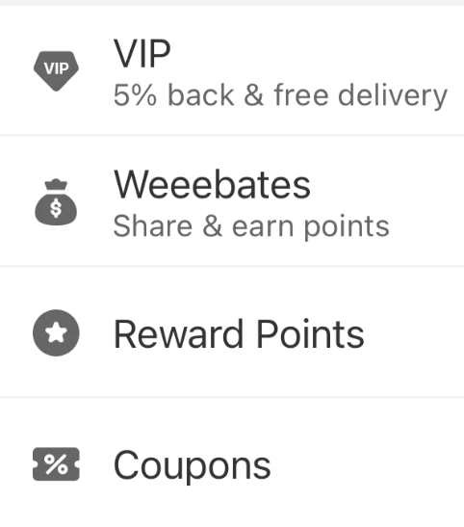
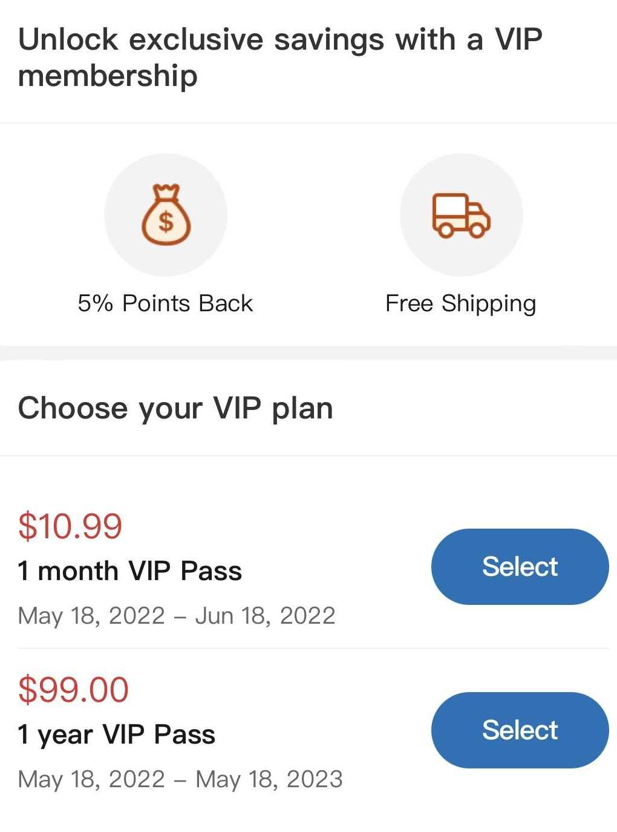
Membership
Current Rewards & Benefits
Regular users: free shipping over $35
New users: First order $10 OFF
VIP users / membership: 5% cash back, free shipping (Charge $11/ month now)
Refer products -- Weeebates: share products from the order you just made to friends via link or post on social medias.
For the referee:
win 1~100 pts back everytime a friend claims the coupon
10% back everytime if the item is purchased
For the referee’s friends: 15% off coupon
Refer Weee! to new users: Both get $20
Benefits:
Coupons
Points: 100:1 in cash
Future Plan:
For APP users, offer $15 OFF on first order.
Offer 21-day free delivery for all new users.
Student Program: Collaborate with International Student Organizations, and offer students with Free VIP trial for 3 months.
Weekly $3 Voucher for VIP.

Slide 29
Customer Lifetime Value
Assumption (base case)
There are approx. 1 million international students enter US each year
20% are asian students
40% of asian students join Weee (80,000 students)
There are 10% of the current 25,000 new local US customer each year (2,500 local customers)
Customer buy $48 two times each month
General advertising and marketing cost is $20 per head
Half of students terminate account because of the graduation and return to home country
The retention rate after 4th year is zero because they are all retired if not graduated
The discount rate is 15%
New customer acquisition cost is $40 ($20 to inviter and $20 to invitee)
The CLV for Asian student is $184.08*
The CLV for local US customer is $216.24*
*see detailed calculation in the supporting document

Slide 30
Customer Lifetime Value
Assumption ($3 weekly voucher in the subscription program)
The same assumption as the base case
Customer buy decrease from $48 to $40 in each order but increase from two orders to three orders each month
The new subscription program increase registration rate by 1.5 times
Almost all register the subscription program (because the return is worthy)
$3 voucher has 70% usage rate (not all people use it every week)
The company obtain $5 x 12 = $60 membership fee per customer in each year
The CLV for Asian students for this case is $212.35* ($28.27 increase)
Revenue from Asian students increase from $14,726,624 to $25,481,520 ($10.7 million increase)
The CLV for local US customers for this case is $253.59* ($34.57 increase)
Revenue from local US customers increase from $540,588 to $950,958 ($410,370 increase)
*see detailed calculation in the supporting document

Slide 31
Customer Lifetime Value
Assumption ($15 discount for the first time APP registration)
The same assumption as the base case
The new subscription program increase registration rate by 1.25 times
The CLV for Asian students for this case is $247.78* ($63.7 increase)
Revenue from Asian students increase from $14,726,624 to $19,822,064 ($5.1 million increase)
The CLV for local US customers for this case is $243.72* ($27.48 increase)
Revenue from local US customers increase from $540,588 to $609,289.95 ($68,701 increase)
*see detailed calculation in the supporting document

Slide 32
Thank you!
Team 2

